Slide 1
Signal and System
Studies in the time domain

Slide 2
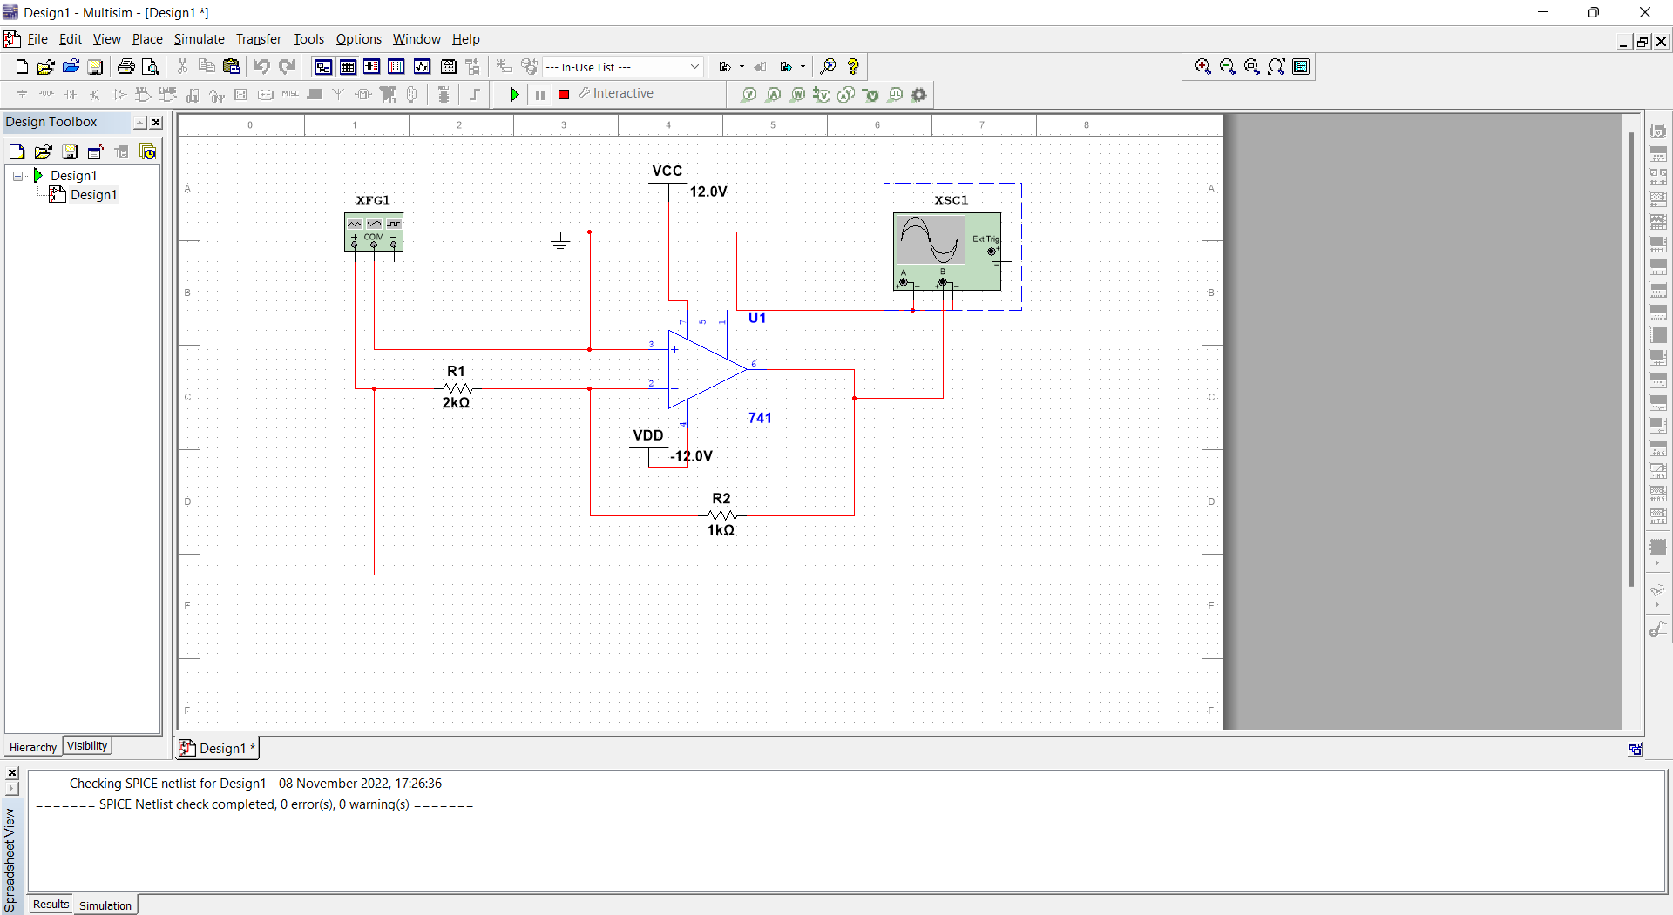
Part-A
Aim: Implementation of a simple inverting amplifier and to check whether the gain (Vout/Vin) remains linear over a range of input voltage and to plot the gain against a swing or profile of input voltage for this.
Circuit:

Slide 3
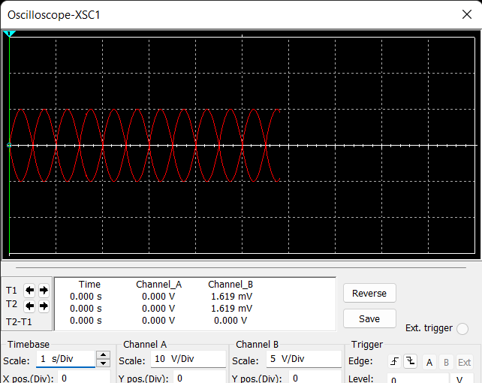
Stimulation:
Frequency:1kHz
Amplitude:10Vp

Slide 4
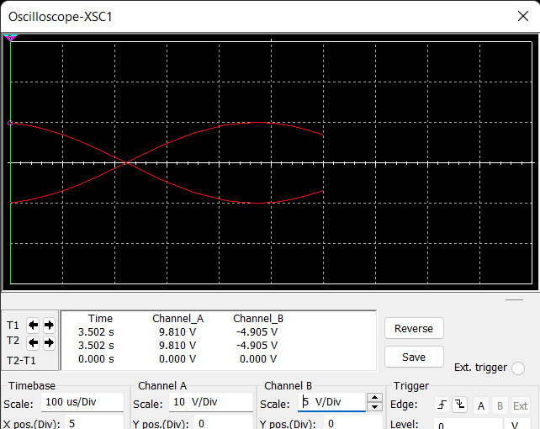
Frequency:1Hz
Amplitude:10Vp

Slide 5
Theory and Graph:
There are two very important rules to remember about Inverting
Amplifiers or any operational amplifier for that matter and these are.
• No Current Flows into the Input Terminals
• The Differential Input Voltage is Zero as V1 = V2 = 0 (Virtual Earth)
Then by using these two rules we can derive the equation for calculating the closed-loop gain of an inverting amplifier, using first principles. Current ( i ) flows through the resistor network as shown.

Slide 6
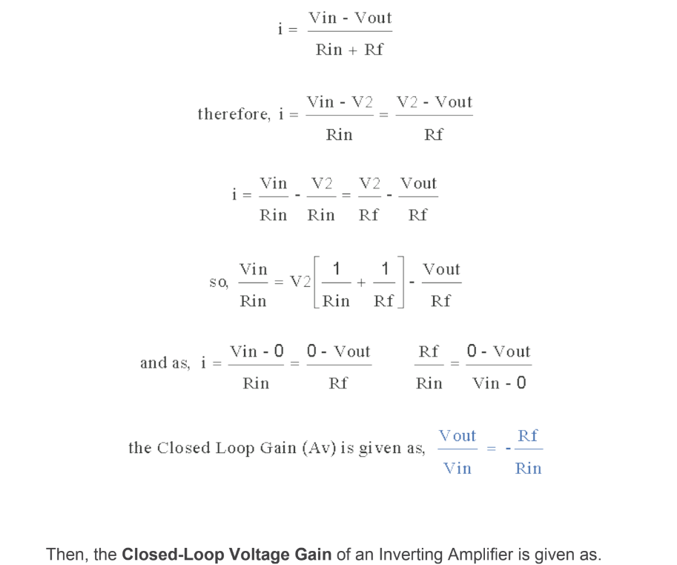

Slide 7
Graph gain vs Vin: Graph Vout vs Vin:

Slide 8
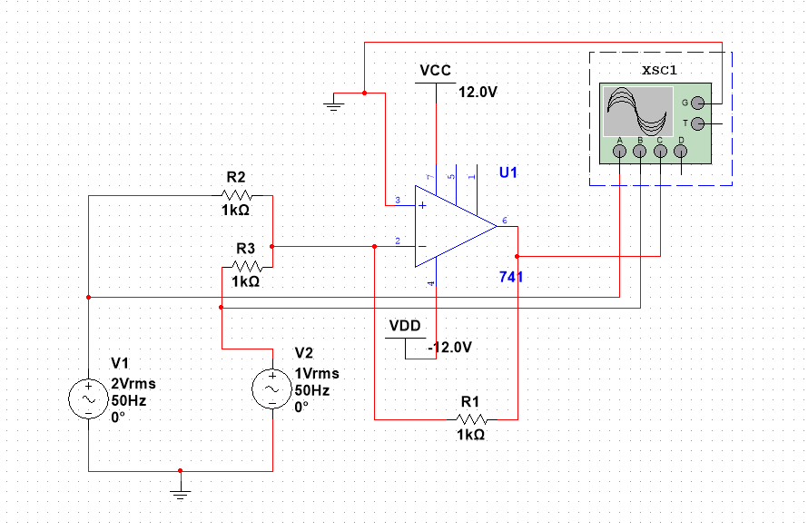
Part-B
Aim: We have to implement a few designs that produce a linear combination of two or more input voltage signals at the output and we have to check different alternatives like sum and differences.
Circuit:

Slide 9
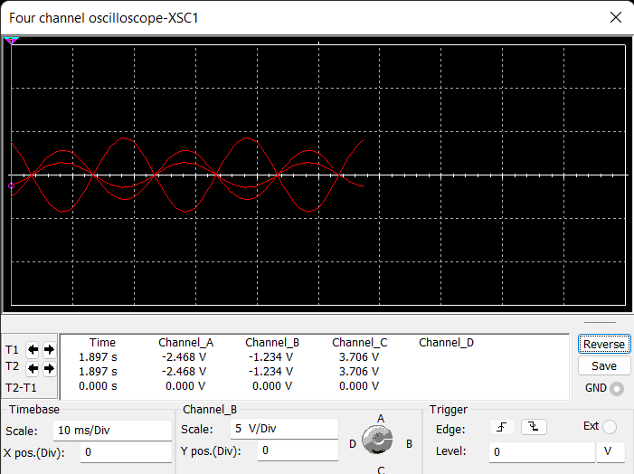
Stimulation:
Frequency:50Hz
V1:2Vrms
R1:2kohm

Slide 10
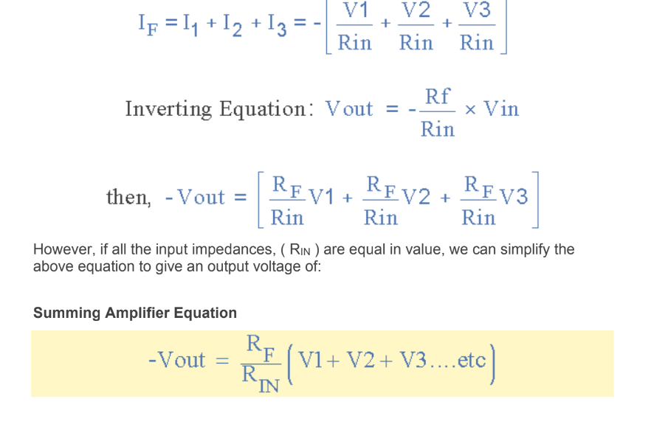
Theory: In this simple summing amplifier circuit, the output voltage, ( Vout ) now becomes proportional to the sum of the input voltages, V1, V2, V3, etc. Then we can modify the original equation for the inverting amplifier to take account of these new inputs thus:

Slide 11
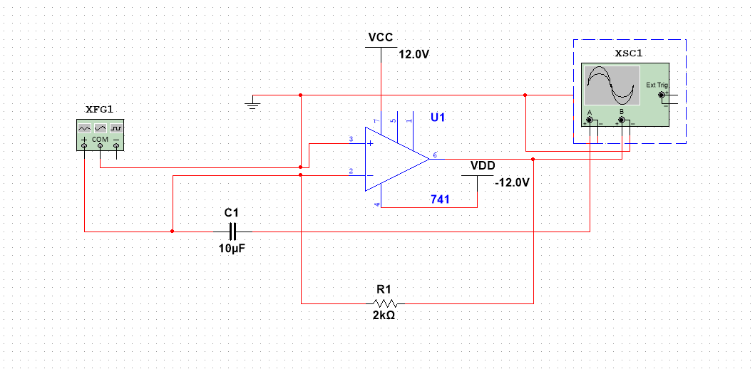
Part-C
Aim: We have to implement the integrator circuit and also the proportional + Integral(PI) circuit and we have to check the output for differentiator input voltage.
Circuit:

Slide 12
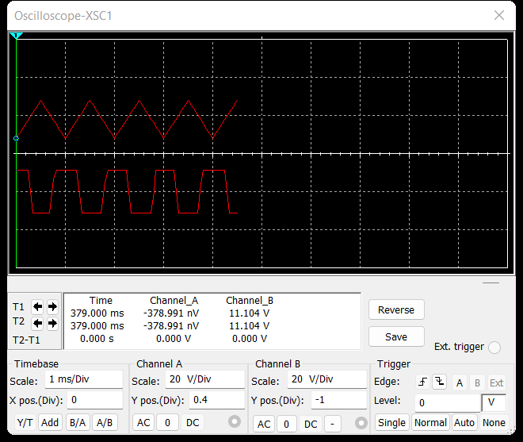
Stimulation:
Frequency:1Hz
Amplitude:10Vp

Slide 13
Theory: The integrator Op-amp produces an output voltage that is proportional to the amplitude and duration of the input signal. By replacing this feedback resistance with a capacitor, we now have an RC Network connected across the operational amplifiers feedback path producing another type of operational amplifier circuit commonly called an Op-amp Integrator circuit as shown below.

Slide 14
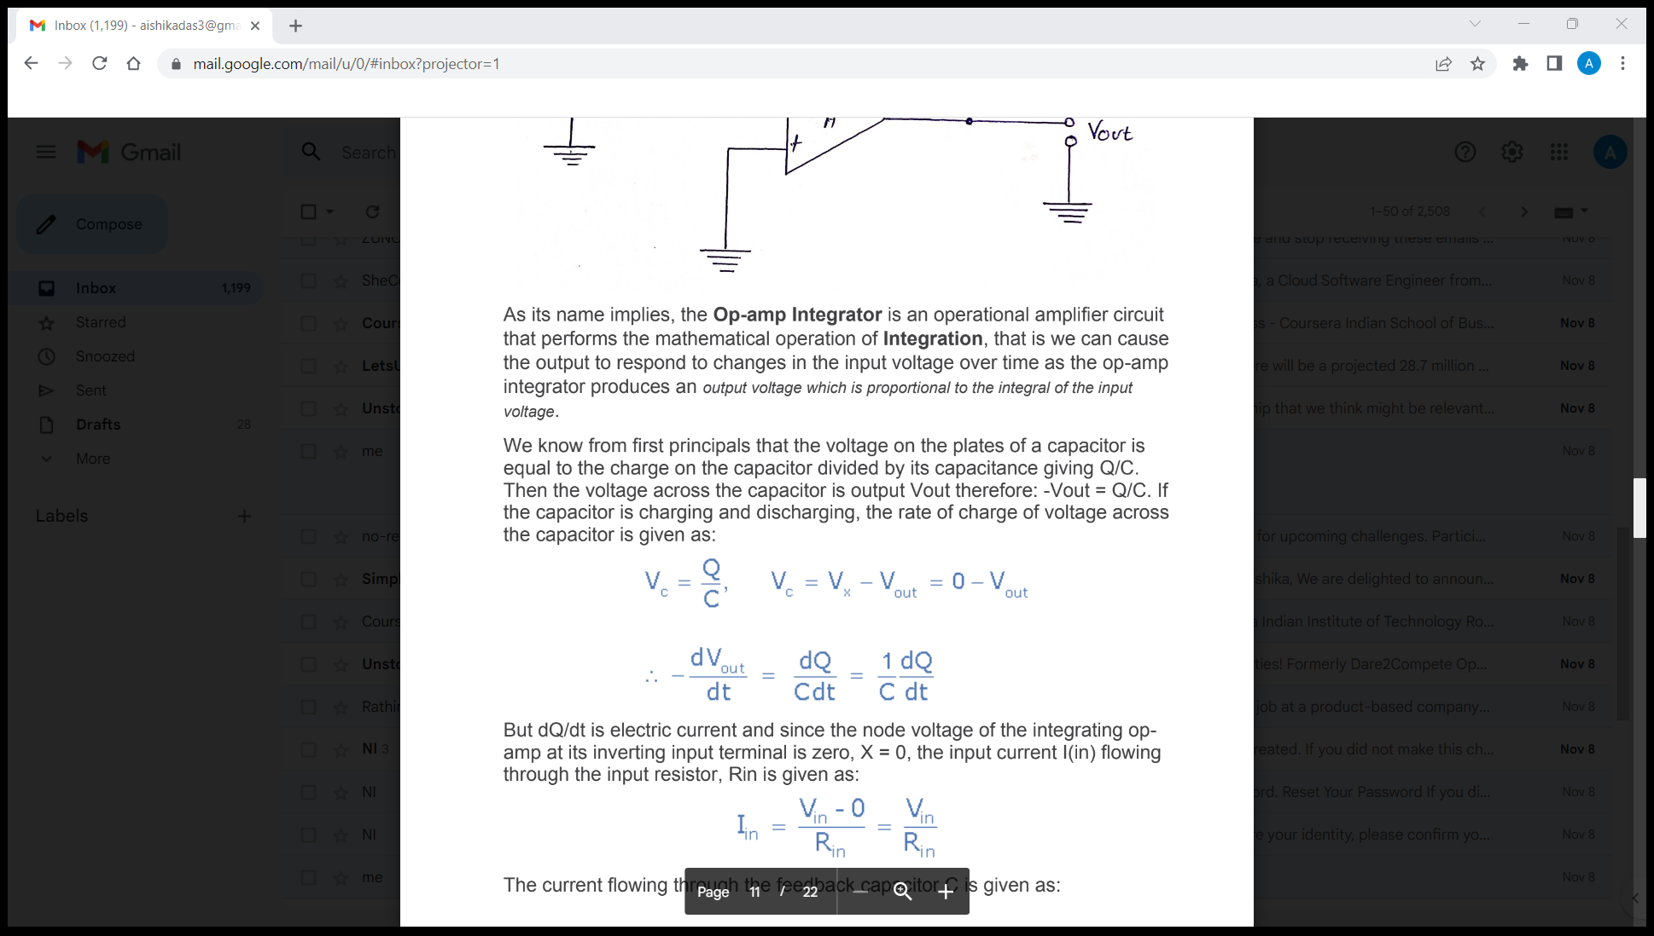
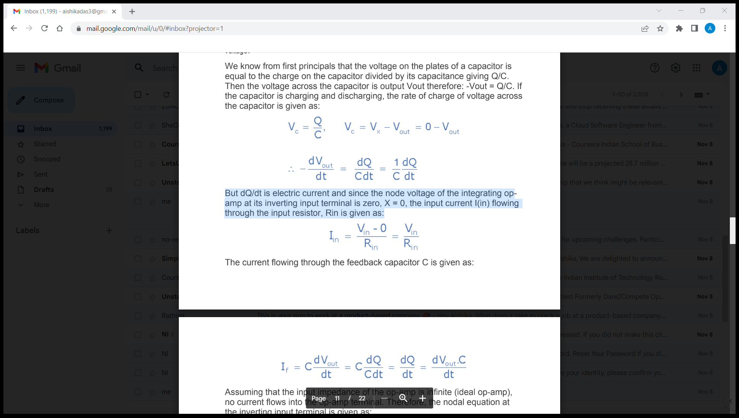
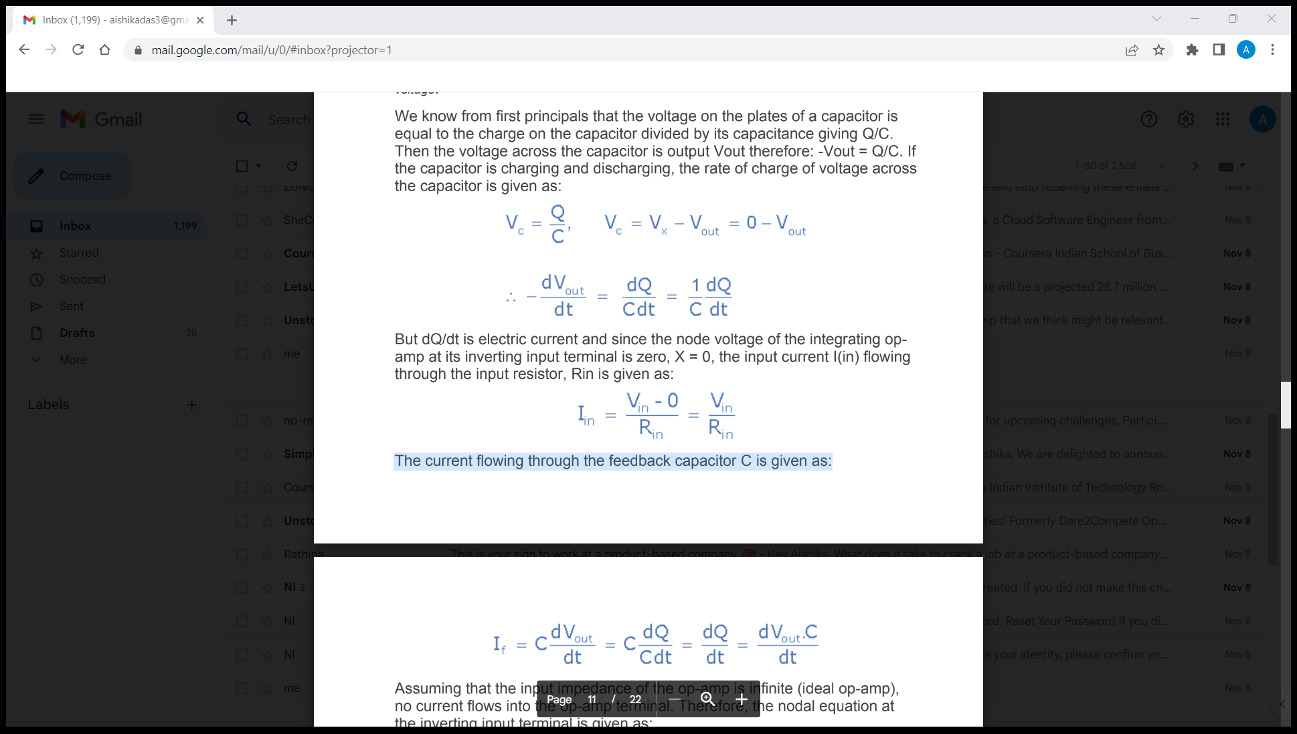
As its name implies, the Op-amp Integrator is an operational amplifier circuit that performs the mathematical operation of Integration, that is we can cause the output to respond to changes in the input voltage over time as the op-amp integrator produces an output voltage that is proportional to the integral of the input voltage. We know from first principles that the voltage on the plates of a capacitor is equal to the charge on the capacitor divided by its capacitance giving Q/C.Then the voltage across the capacitor is output Vout therefore: -Vout = Q/C. If the capacitor is charging and discharging, the rate of change of voltage across the capacitor is given as:
But dQ/dt is electric current and since the node voltage of the integrating op-amp at its inverting input terminal is zero, X = 0, the input current I(in) flowing through the input resistor, Rin is given as:
The current flowing through the feedback capacitor C is given as:

Slide 15
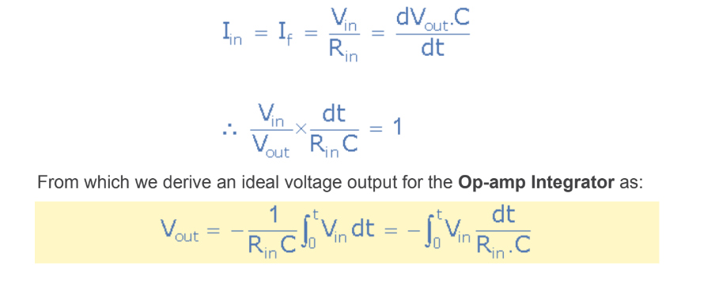
Assuming that the input impedance of the op-amp is infinite (ideal op-amp), no current flows into the op-amp terminal. Therefore, the nodal equation at the inverting input terminal is given as:

Slide 16
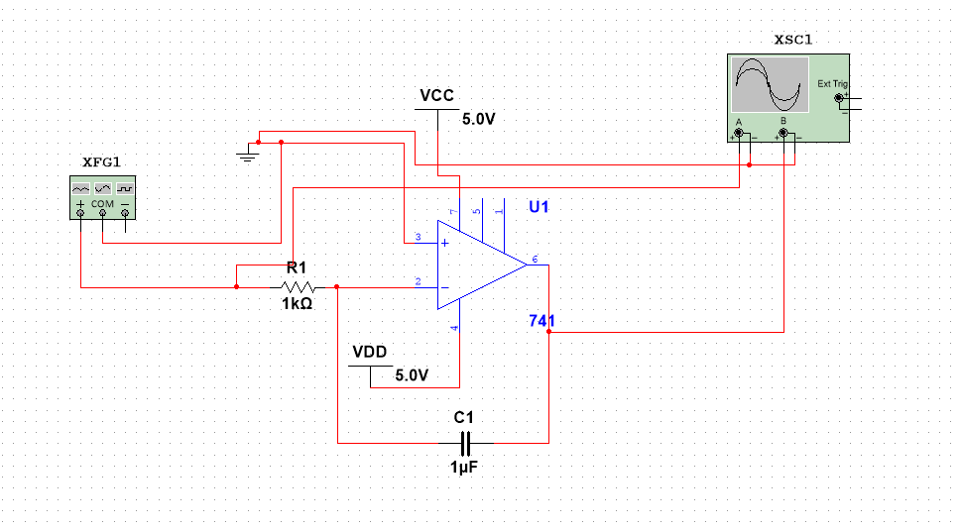
Circuit for PI:

Slide 17
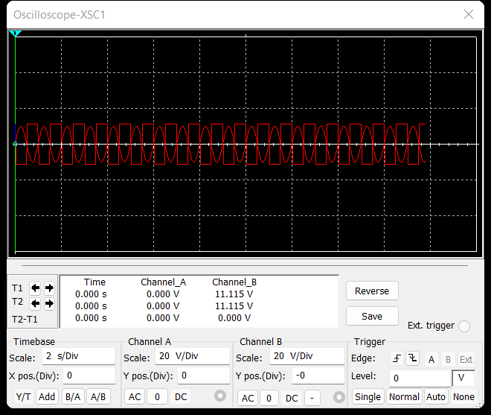
Stimulation(For sin waveform):

Slide 18
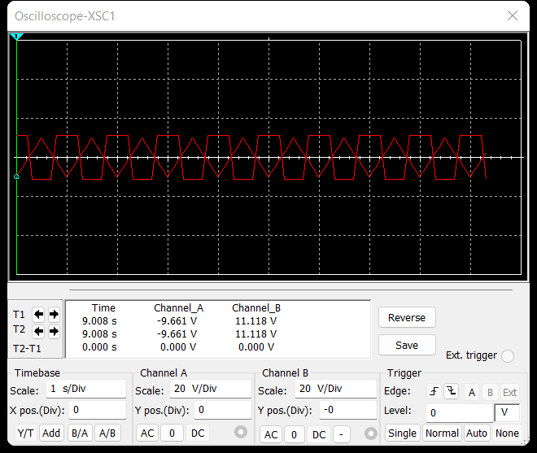
(For triangular waveform)

Slide 19
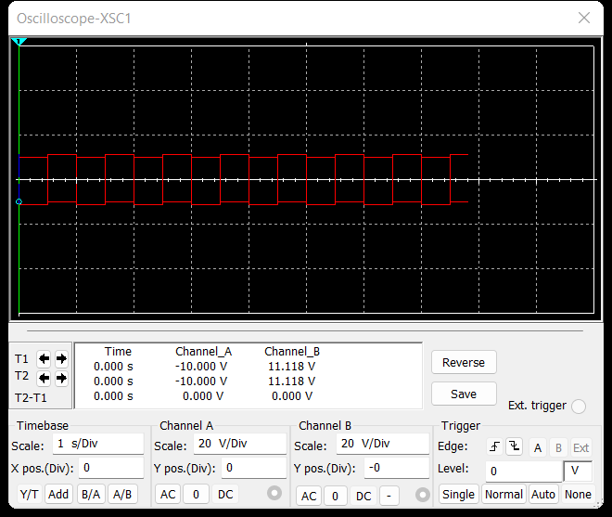
(For square waveform):

Slide 20
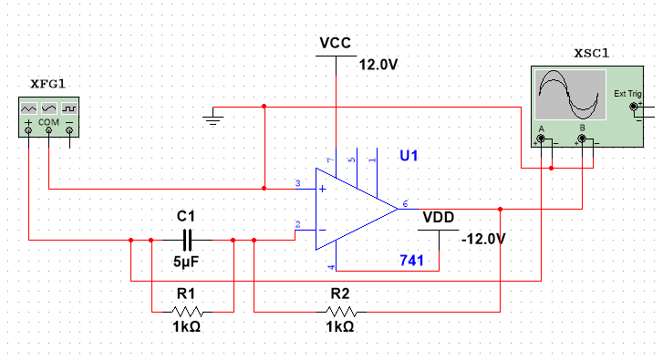
Part - D
Aim: Implement the differentiator circuit and also the Proportional+Integral+Derivative(PD) circuit. Check the output for different input voltage profiles alike in C above.
Circuit(PD):

Slide 21
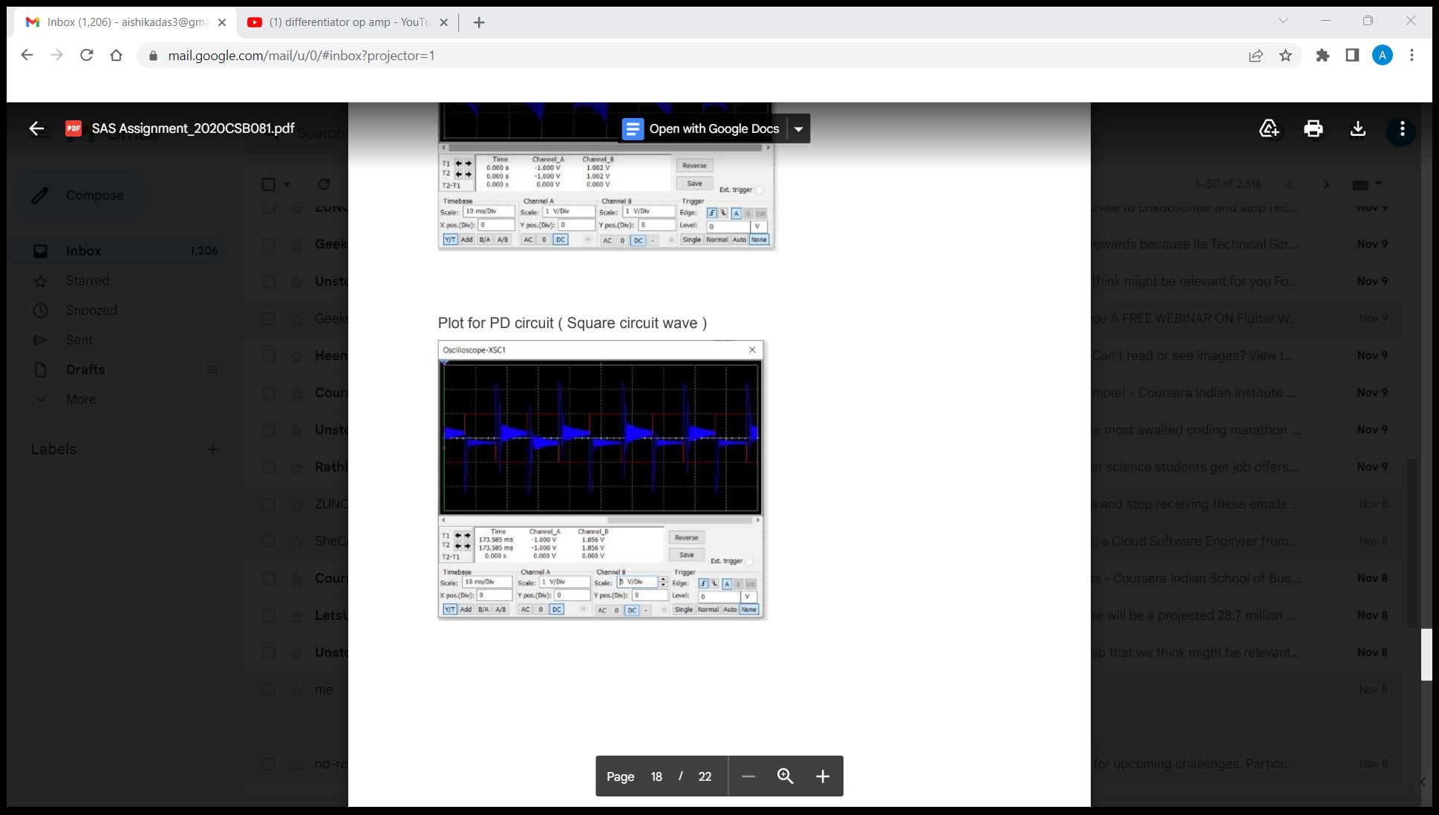
Stimulation(For Square wave):

Slide 22
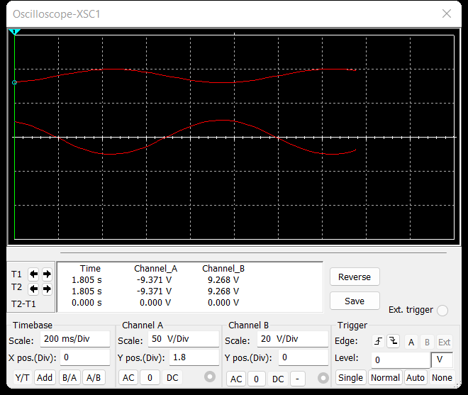
(For sin wave):

Slide 23
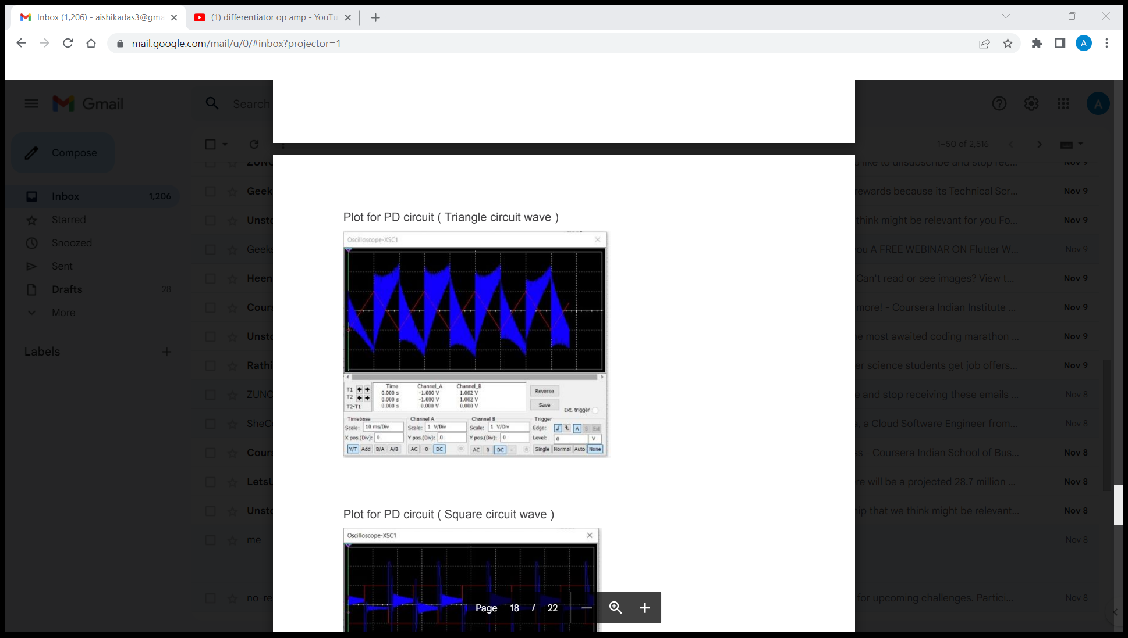
(For Triangular wave):

Slide 24
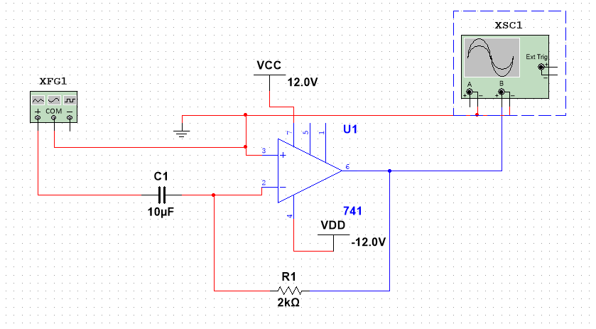
Circuit for Differentiator:

Slide 25
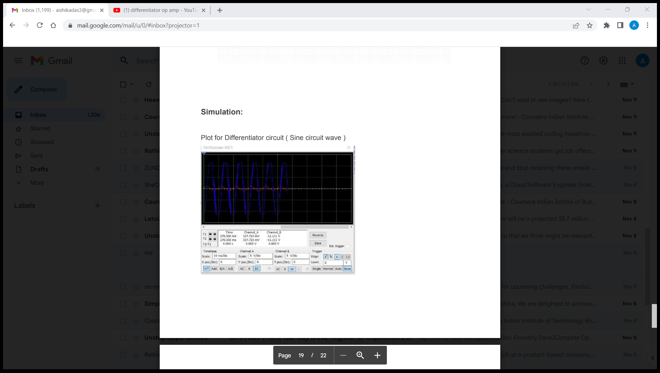
Stimulation(For sin wave):

Slide 26
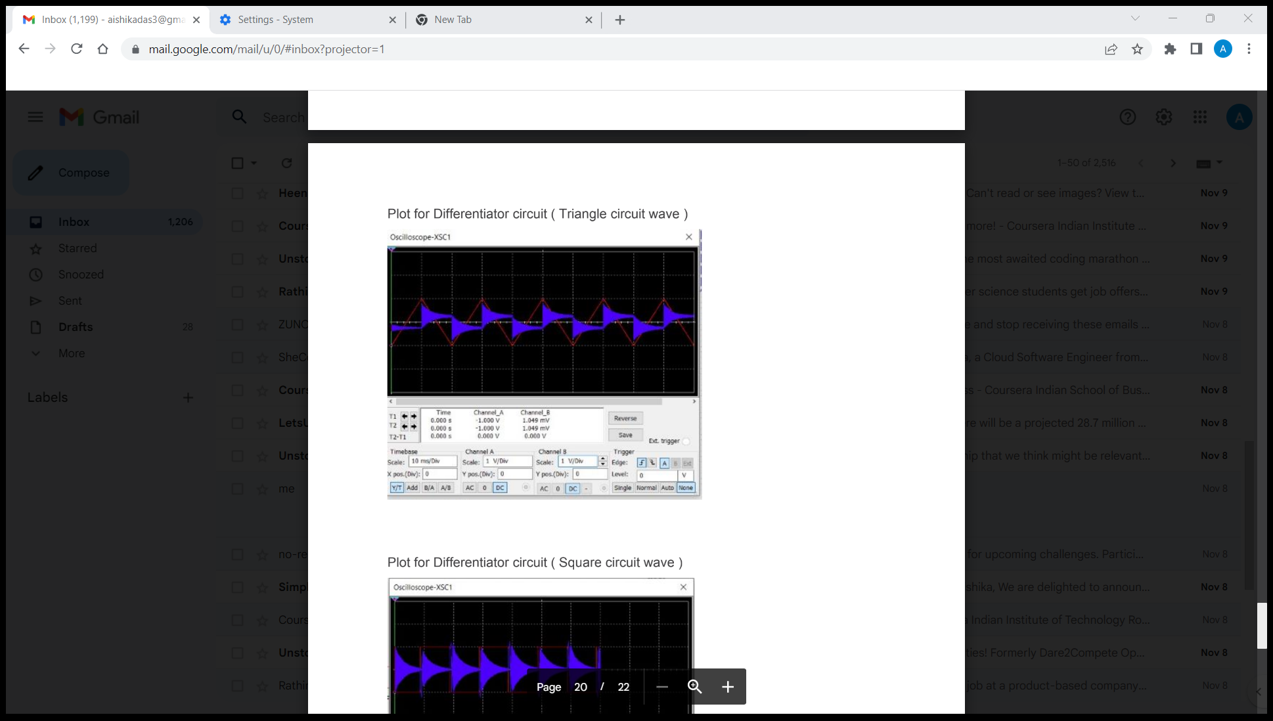
Stimulation(For triangular wave):

Slide 27
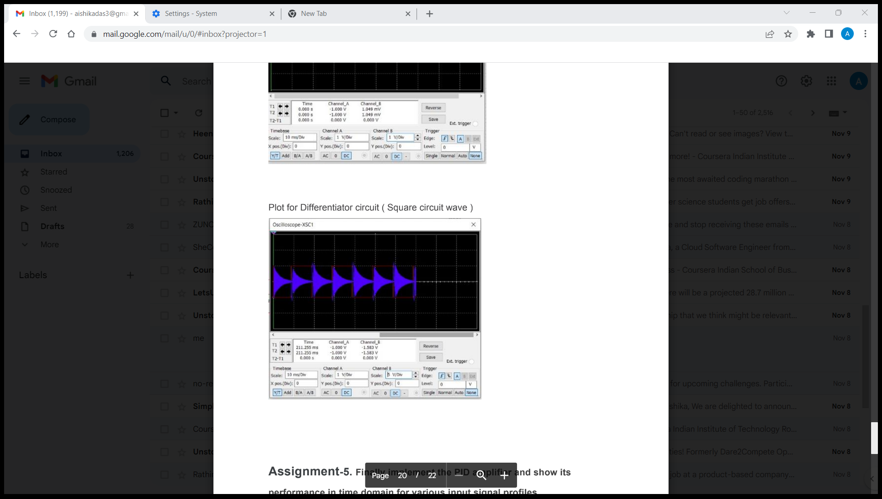
For stimulation(Square wave)

Slide 28
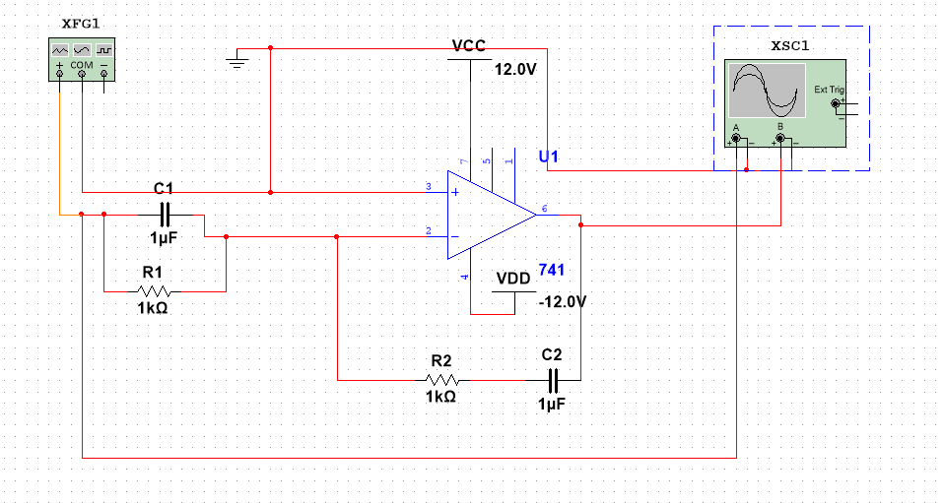
Part-E
Aim: Implement the PID amplifier and show its performance in the time domain for various input signal profiles.
Circuit:

Slide 29
Stimulation(For sine):

